Slide 1
Piscatorial Percentages
Source: John Mason
Opening plenary ATM 2015

Slide 2



Piscatorial Percentages
A fish tank contains 200 fish.
98% of them are small, the rest are large.
I want to remove some of the small fish so that the remainder form 96% of the fish left in the tank.
How many should I remove?

Slide 3


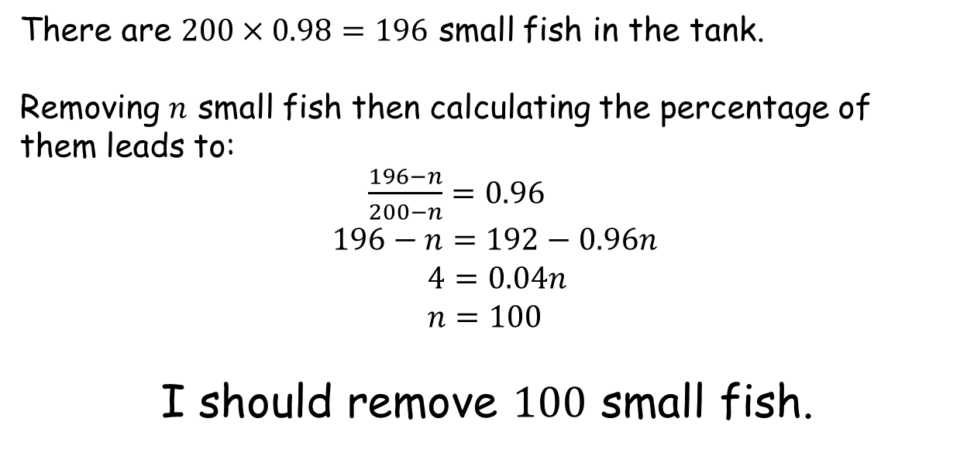
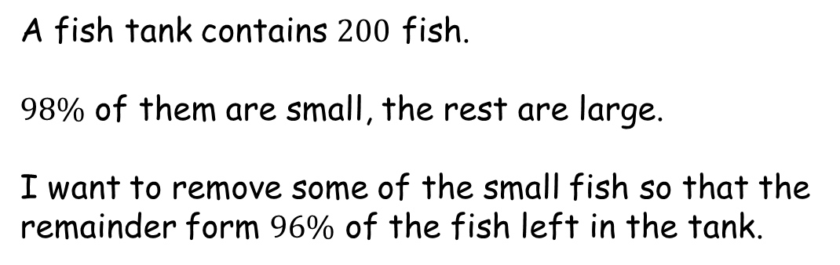
Piscatorial Percentages
A fish tank contains $200$ fish.
$98\%$ of them are small, the rest are large.
I want to remove some of the small fish so that the remainder form $96\%$ of the fish left in the tank.
There are $200×0.98=196$ small fish in the tank.
Removing $n$ small fish then calculating the percentage of them leads to:
$\frac{196−n}{200−n}=0.96$
$196−n=192−0.96n$
$4=0.04n$
$n=100$
I should remove $100$ small fish.

Slide 4

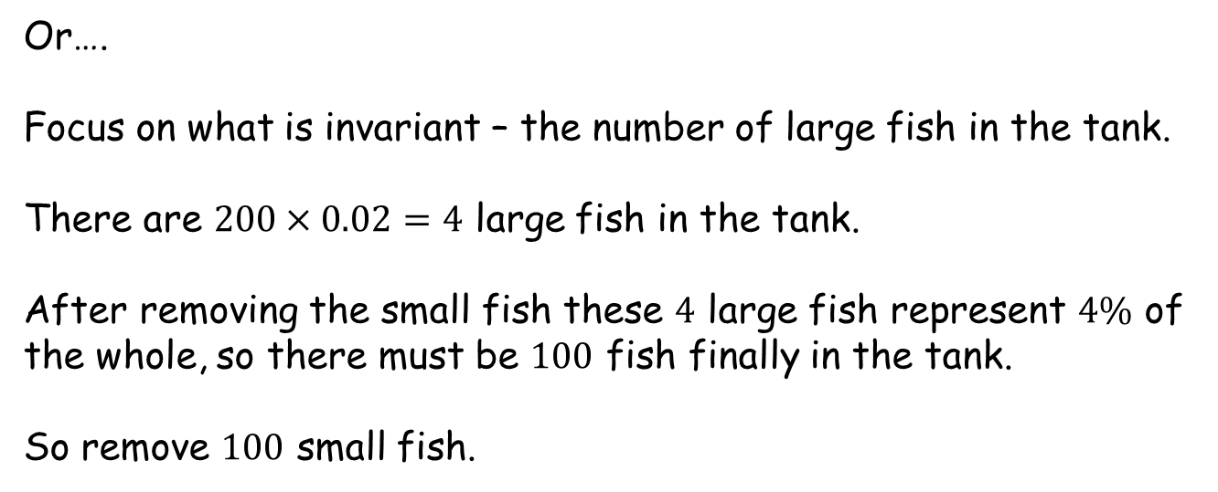
Piscatorial Percentages
A fish tank contains $200$ fish.
$98\%$ of them are small, the rest are large.
I want to remove some of the small fish so that the remainder form $96\%$ of the fish left in the tank.
Or….
Focus on what is invariant – the number of large fish in the tank.
There are $200×0.02=4$ large fish in the tank.
After removing the small fish these $4$ large fish represent $4\%$ of the whole, so there must be $100$ fish finally in the tank.
So remove $100$ small fish.

Slide 5
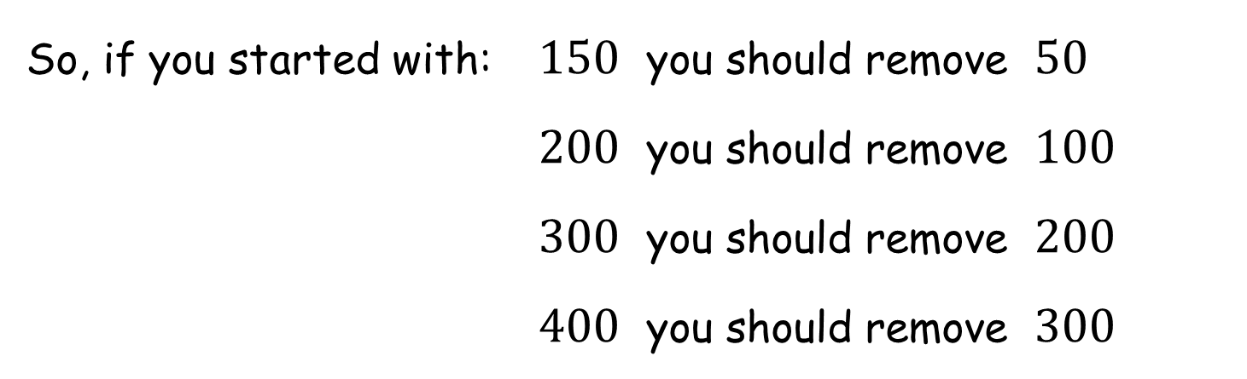
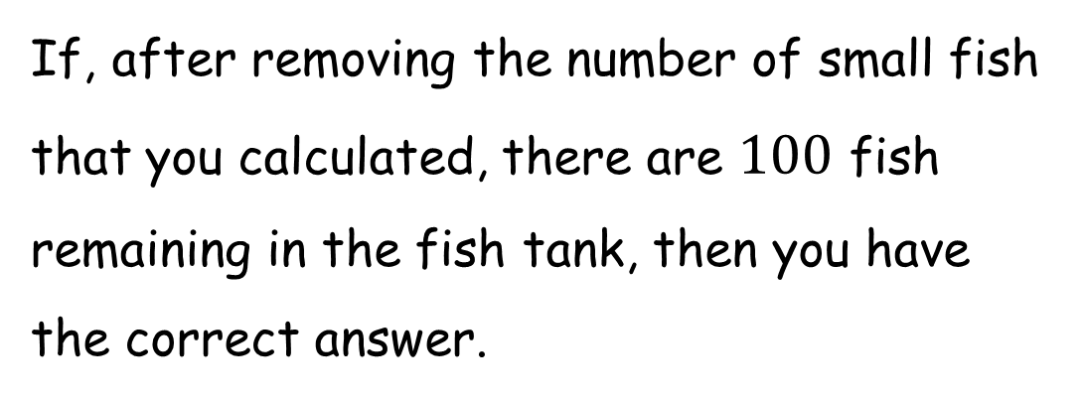
Piscatorial Percentages
If, after removing the number of small fish that you calculated, there are $100$ fish remaining in the fish tank, then you have the correct answer.
So, if you started with: $150$ you should remove $50$
$200$ you should remove $100$
$300$ you should remove $200$
$400$ you should remove $300$

Slide 7
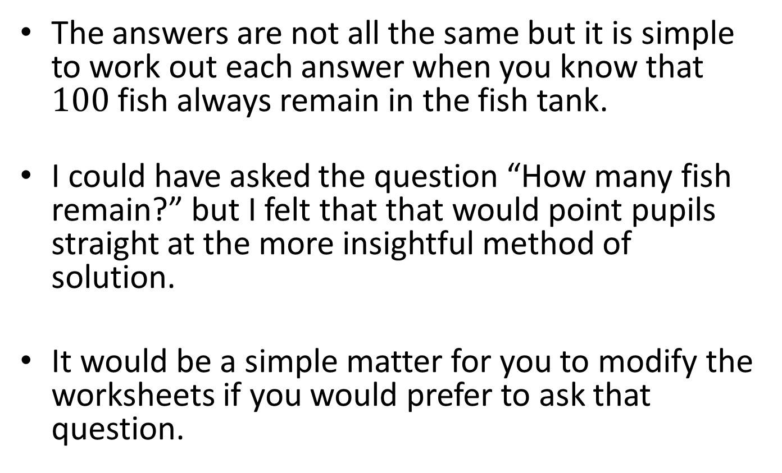
Note to Teacher
The answers are not all the same but it is simple to work out each answer when you know that $100$ fish always remain in the fish tank.
I could have asked the question “How many fish remain?” but I felt that that would point pupils straight at the more insightful method of solution.
It would be a simple matter for you to modify the worksheets if you would prefer to ask that question.

Slide 8
RESOURCES

Slide 9
SIC_45
Piscatorial Percentages
A fish tank contains 200 fish.
98% of them are small, the rest are large.
I want to remove some of the small fish so that the remainder form 96% of the fish left in the tank.
How many should I remove?

Slide 10
SIC_45
Piscatorial Percentages
A fish tank contains 200 fish.
97% of them are small, the rest are large.
I want to remove some of the small fish so that the remainder form 94% of the fish left in the tank.
How many should I remove?

Slide 11
SIC_45
Piscatorial Percentages
A fish tank contains 200 fish.
96% of them are small, the rest are large.
I want to remove some of the small fish so that the remainder form 92% of the fish left in the tank.
How many should I remove?

Slide 12
SIC_45
Piscatorial Percentages
A fish tank contains 200 fish.
95% of them are small, the rest are large.
I want to remove some of the small fish so that the remainder form 90% of the fish left in the tank.
How many should I remove?

Slide 13
SIC_45
Piscatorial Percentages
A fish tank contains 200 fish.
94% of them are small, the rest are large.
I want to remove some of the small fish so that the remainder form 88% of the fish left in the tank.
How many should I remove?

Slide 14
SIC_45
Piscatorial Percentages
A fish tank contains 300 fish.
98% of them are small, the rest are large.
I want to remove some of the small fish so that the remainder form 94% of the fish left in the tank.
How many should I remove?

Slide 15
SIC_45
Piscatorial Percentages
A fish tank contains 300 fish.
97% of them are small, the rest are large.
I want to remove some of the small fish so that the remainder form 91% of the fish left in the tank.
How many should I remove?

Slide 16
SIC_45
Piscatorial Percentages
A fish tank contains 300 fish.
96% of them are small, the rest are large.
I want to remove some of the small fish so that the remainder form 88% of the fish left in the tank.
How many should I remove?

Slide 17
SIC_45
Piscatorial Percentages
A fish tank contains 300 fish.
95% of them are small, the rest are large.
I want to remove some of the small fish so that the remainder form 85% of the fish left in the tank.
How many should I remove?

Slide 18
SIC_45
Piscatorial Percentages
A fish tank contains 150 fish.
98% of them are small, the rest are large.
I want to remove some of the small fish so that the remainder form 97% of the fish left in the tank.
How many should I remove?

Slide 19
SIC_45
Piscatorial Percentages
A fish tank contains 150 fish.
96% of them are small, the rest are large.
I want to remove some of the small fish so that the remainder form 94% of the fish left in the tank.
How many should I remove?

Slide 20
SIC_45
Piscatorial Percentages
A fish tank contains 150 fish.
94% of them are small, the rest are large.
I want to remove some of the small fish so that the remainder form 91% of the fish left in the tank.
How many should I remove?

Slide 21
SIC_45
Piscatorial Percentages
A fish tank contains 150 fish.
92% of them are small, the rest are large.
I want to remove some of the small fish so that the remainder form 88% of the fish left in the tank.
How many should I remove?

Slide 22
SIC_45
Piscatorial Percentages
A fish tank contains 400 fish.
98% of them are small, the rest are large.
I want to remove some of the small fish so that the remainder form 92% of the fish left in the tank.
How many should I remove?

Slide 23
SIC_45
Piscatorial Percentages
A fish tank contains 400 fish.
97% of them are small, the rest are large.
I want to remove some of the small fish so that the remainder form 88% of the fish left in the tank.
How many should I remove?

Slide 24
SIC_45
Piscatorial Percentages
A fish tank contains 400 fish.
96% of them are small, the rest are large.
I want to remove some of the small fish so that the remainder form 84% of the fish left in the tank.
How many should I remove?

